Slide 1
Activation Functions & Loss Functions
By : - Ravi

Slide 2

Activation Functions
What is activation function ?
Decide whether a neuron should be activated or not.
Whether the information that the neuron is receiving is relevant for the given information or should it be ignored.
It is the non linear transformation that we do over the input signal.
This transformed output is then send to the next layer of neurons as input.

Slide 3
Need of Activation Functions
Can we do without an activation function?
If we do not apply a Activation function then the output signal would simply be a simple linear function.
A linear equation is simple to solve but is limited in its capacity to solve complex problems. A neural network without an activation function is essentially just a linear regression model.
The activation function does the non-linear transformation to the input making it capable to learn and perform more complex tasks.
We would want our neural networks to work on complicated tasks like language translations and image classifications.

Slide 4
Popular Activation Functions
Linear Function
Sigmoid or Logistic
Softmax Function
Tanh – Hyperbolic Tangent
ReLU – Rectified Linear Units

Slide 5
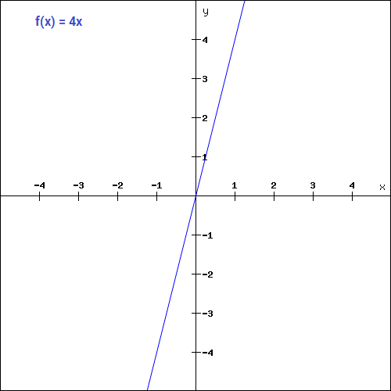
Linear Function f = cx

Slide 6
Linear Function
A straight line function where activation is proportional to input ( which is the weighted sum from neuron ).
This way, it gives a range of activations, so it is not binary activation. We can definitely connect a few neurons together and if more than 1 fires, we could take the max and decide based on that. So that is ok too. Then what is the problem with this ?
If you are familiar with gradient descent for training, you would notice that for this function, derivative is a constant.

Slide 7
Linear Function
f = cx, derivative with respect to x is c.
That means, the gradient has no relationship with X. It is a constant gradient and the descent is going to be on constant gradient. If there is an error in prediction, the changes made by back propagation is constant and not depending on the change in input delta(x).

Slide 8
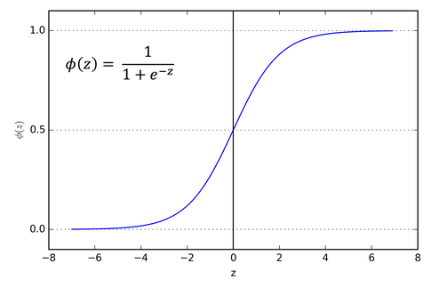
Sigmoid Function

Slide 9
Sigmoid Function
It is a activation function of form f(x) = 1 / 1 + exp(-x) . Its Range is between 0 and 1. It is a S — shaped curve. It is easy to understand and apply but it has major reasons which have made it fall out of popularity -
Vanishing gradient problem
Secondly , its output isn’t zero centered. It makes the gradient updates go too far in different directions. 0 < output < 1, and it makes optimization harder.
Sigmoid saturate and kill gradients.
Sigmoid have slow convergence.

Slide 10
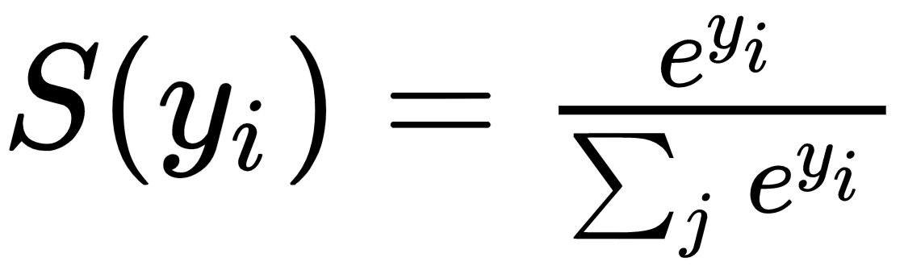
Softmax Function

Slide 11
Softmax Function
What if we have to handle multiple classes ?
The softmax function is also a type of sigmoid function but is handy when we are trying to handle classification problems.
The sigmoid function as we saw earlier was able to handle just two classes. What shall we do when we are trying to handle multiple classes. Just classifying yes or no for a single class would not help then.
The softmax function would squeeze the outputs for each class between 0 and 1 and would also divide by the sum of the outputs. This essentially gives the probability of the input being in a particular class.

Slide 12
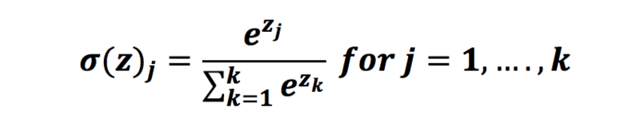
Softmax Function
In mathematics, the softmax function (normalized exponential function) is a generalization of the logistic function
transforms the values in the range [0,1] that add up to 1
the softmax function is used in various multiclass classification methods
For example: when we classify handwritten digits ...
We use the softmax activation function in the last layer because we want to classify handwritten digits, we choose the class with the highest probability

Slide 13
Softmax Example
If we take an input of [1, 2, 3, 4, 1, 2, 3], the softmax of that is [0.024, 0.064, 0.175, 0.475, 0.024, 0.064, 0.175]. The output has most of its weight where the '4' was in the original input. This is what the function is normally used for: to highlight the largest values and suppress values which are significantly below the maximum value.
But if: softmax is not scale invariant, so if the input were [0.1, 0.2, 0.3, 0.4, 0.1, 0.2, 0.3] (which sums to 1.6) the softmax would be [0.125, 0.138, 0.153, 0.169, 0.125, 0.138, 0.153]. This shows that for values between 0 and 1 softmax, in fact, de-emphasizes the maximum value (note that 0.169 is not only less than 0.475, it is also less than the initial value of 0.4).

Slide 14
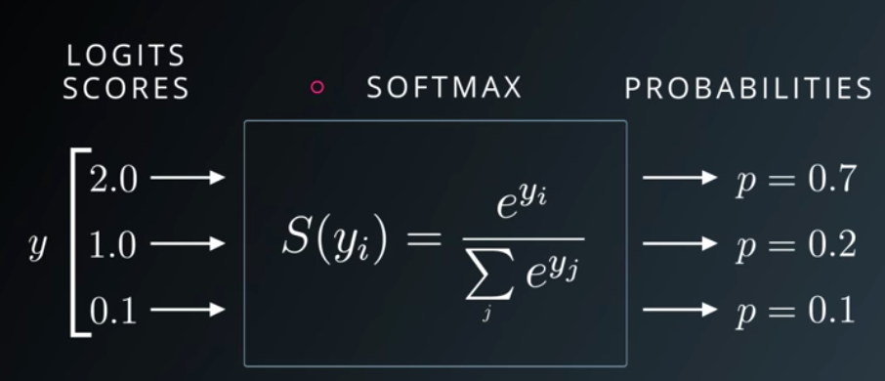
Implementation of Sigmoid

Slide 15
Implementation of Sigmoid
import numpy as np
z = [2.0,1.0,0.1]
exp = [np.exp(i) for i in z]
We use numpy.exp(power) to take the special number e to any power we want. We use python list comprehension to iterate through each of the logits, and compute np.exp(z).
We just computed the top part of the softmax for each logit. Each of these transformed logit needs to be normalized by another number — the sum of all the transformed logits. This normalized give us nice probabilities outputs that sum to one!

Slide 16
Implementation of Sigmoid
We compute the sum of all the transformed logits and store the sum in sum_of_exps.
sumExp = sum(exp)
Now we need to write the final part of our softmax function: each transformed logits need to be normalized
softmax = [ j / sumExp for j in exp ]
we use python list comprehension: we grab each transformed logit using [j for j in exps] divide each j by the sum_of_exps.
List comprehension gives us a list back.

Slide 17
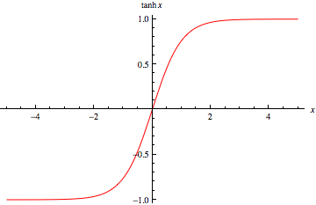
Tanh Function

Slide 18
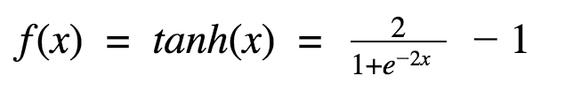

Tanh Function
It’s mathematical formula is:
This looks very similar to sigmoid. In fact, it is a scaled sigmoid function!
Now it’s output is zero centered because its range in between -1 to 1 i.e., -1 < output < 1 . Hence optimization is easier in this method hence in practice it is always preferred over Sigmoid function.

Slide 19
Tanh Function
It is nonlinear in nature,
It is bound to range (-1, 1) so no worries of activations blowing up.
One point to mention is that the gradient is stronger for tanh than sigmoid ( derivatives are steeper).
Deciding between the sigmoid or tanh will depend on your requirement of gradient strength. Like sigmoid, tanh also has the vanishing gradient problem.

Slide 20
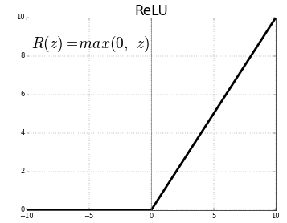
ReLU Function

Slide 21
ReLU Function
The ReLU function is the Rectified linear unit. It is the most widely used activation function. It is defined as - R(x) = max(0,x)
the ReLU function is non linear, which means we can easily backpropagate the errors and have multiple layers of neurons being activated by the ReLU function.
It gives an output x if x is positive and 0 otherwise.
It was recently proved that it had 6 times improvement in convergence from Tanh function. It’s just R(x) = max(0,x)
if x < 0 , R(x) = 0 and if x >= 0 , R(x) = x.
Hence as seeing the mathematical form of this function we can see that it is very simple and efficient. Also it avoids and rectifies vanishing gradient problem .

Slide 22
ReLU Function
The main advantage of using the ReLU function over other activation functions is that it does not activate all the neurons at the same time.
If you look at the ReLU function if the input is negative it will convert it to zero and the neuron does not get activated.
This means that at a time only a few neurons are activated making the network sparse making it efficient and easy for computation.
ReLu is less computationally expensive than tanh and sigmoid because it involves simpler mathematical operations.

Slide 23
Leaky ReLU
Leaky ReLU function is nothing but an improved version of the ReLU function.
Problem with ReLu - is that some gradients can be fragile during training and can die. It can cause a weight update which will makes it never activate on any data point again. Simply saying that ReLu could result in Dead Neurons.
Because of the horizontal line in ReLu( for negative X ), the gradient can go towards 0. For activations in that region of ReLu, gradient will be 0 because of which the weights will not get adjusted during descent.
That means, those neurons which go into that state will stop responding to variations in error/ input ( simply because gradient is 0, nothing changes ). This is called dying ReLu problem.

Slide 24
Leaky ReLU
This problem can cause several neurons to just die and not respond making a substantial part of the network passive.
There are variations in ReLu to mitigate this issue by simply making the horizontal line into non-horizontal component.
for example y = 0.01x for x<0 will make it a slightly inclined line rather than horizontal line. This is leaky ReLu.
There are other variations too. The main idea is to let the gradient be non zero and recover during training eventually.

Slide 25
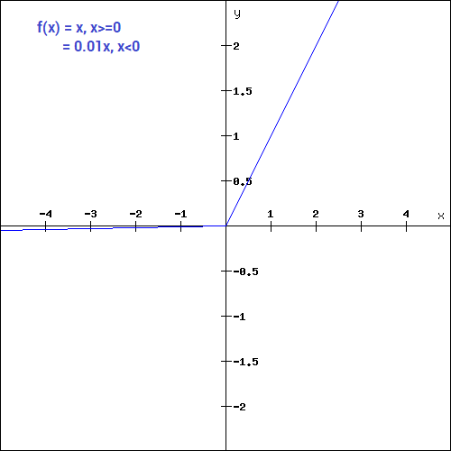
Leaky ReLU
What we have done here is that we have simply replaced the horizontal line with a non-zero, non-horizontal line. Here a is a small value like 0.01 or so. It can be represented on the graph as-

Slide 26
Choosing right function
Sigmoid functions and their combinations generally work better in the case of classifiers
Sigmoids and tanh functions are sometimes avoided due to the vanishing gradient problem
ReLU function is a general activation function and is used in most cases these days
If we encounter a case of dead neurons in our networks the leaky ReLU function is the best choice
Always keep in mind that ReLU function should only be used in the hidden layers
As a rule of thumb, you can begin with using ReLU function and then move over to other activation functions in case ReLU doesn’t provide with optimum results

Slide 27
Loss Functions
We want to make sure the predictions made by the network is approximately the same as the labels in the dataset.
It measures the inconsistency between predicted value and actual label.
It is a non-negative value, where the robustness of model increases along with the decrease of the value of loss function.
In most learning networks, error is calculated as the difference between the actual output and the predicted output.

Slide 28

Loss Function
The function that is used to compute this error is known as Loss Function J(.). Different loss functions will give different errors for the same prediction, and thus have a considerable effect on the performance of the model. One of the most widely used loss function is mean square error, which calculates the square of difference between actual value and predicted value. Different loss functions are used to deal with different type of tasks, i.e. regression and classification.

Slide 29
Types of Loss Function
MSE – Mean Squared Error
MAE – Mean Absolute Error
Cross Entropy
Negative Log Likelihood
Hinge Loss
Kullback-Liebler Divergence

Slide 30
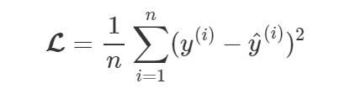
MSE – Mean Squared Error
Mean Squared Error (MSE), or quadratic, loss function is widely used in linear regression as the performance measure, and the method of minimizing MSE is called Ordinary Least Squares (OSL), the basic principle of OSL is that the optimized fitting line should be a line which minimizes the sum of distance of each point to the regression line, i.e., minimizes the quadratic sum. The standard form of MSE loss function is defined as

Slide 31
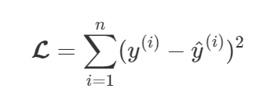
MSE – Mean Squared Error
where (y(i)−^y(i)) is named as residual, and the target of MSE loss function is to minimize the residual sum of squares.
L2 Loss Function
L2 loss function is the square of the L2 norm of the difference between actual value and predicted value. It is mathematically similar to MSE, only do not have division by n, it is computed by

Slide 32
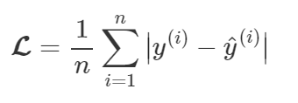
MAE – Mean Absolute Error
Mean Absolute Error (MAE) is another loss function used for regression models. MAE is the sum of absolute differences between our target and predicted variables. So it measures the average magnitude of errors in a set of predictions, without considering their directions.
where |⋅| denotes the absolute value.

Slide 33
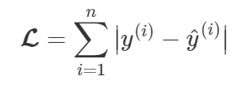
MAE – Mean Absolute Error
L1 Loss Function
L1 loss function is sum of absolute errors of the difference between actual value and predicted value. Similar to the relation between MSE and L2, L1 is mathematically similar to MAE, only do not have division by n, and it is defined as

Slide 34
MSE Vs MAE
MSE has nice mathematical properties which makes it easier to compute the gradient.
MAE requires more complicated tools such as linear programming to compute the gradient. Because of the square, large errors have relatively greater influence on MSE than do the smaller error.
Therefore, MAE is more robust to outliers since it does not make use of square. On the other hand, MSE is more useful if concerning about large errors whose consequences are much bigger than equivalent smaller ones.
MSE also corresponds to maximizing the likelihood of Gaussian random variables.

Slide 35
MSE Vs MAE
MAE loss is useful if the training data is corrupted with outliers (i.e. we erroneously receive unrealistically huge negative/positive values in our training environment, but not our testing environment).
Intuitively, we can think about it like this: If we only had to give one prediction for all the observations that try to minimize MSE, then that prediction should be the mean of all target values. But if we try to minimize MAE, that prediction would be the median of all observations. We know that median is more robust to outliers than mean, which consequently makes MAE more robust to outliers than MSE.

Slide 36

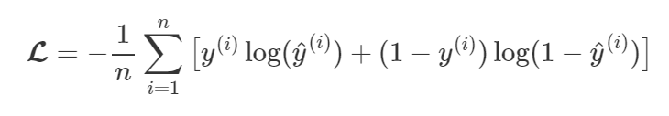
Cross Entropy
Cross Entropy is commonly-used in binary classification (labels are assumed to take values 0 or 1) as a loss function and defined as
where yi is the target label and pi is the predicted probability of that label for a given observation.
(For multi-classification, use Multi-class Cross Entropy), which is computed by

Slide 37
Cross Entropy
Cross entropy measures the divergence between two probability distribution, if the cross entropy is large, which means that the difference between two distribution is large, while if the cross entropy is small, which means that two distribution is similar to each other.
As we know that in MSE that it suffers slow divergence when using Sigmoid as activation function, here the cross entropy does not have such problem.

Slide 38
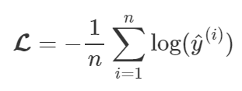
Negative Logarithmic Likelihood
Negative Log Likelihood loss function is widely used in neural networks, it measures the accuracy of a classifier. It is used when the model outputs a probability for each class, rather than just the most likely class. It is a “soft” measurement of accuracy that incorporates the idea of probabilistic confidence. It is similar to cross entropy mathematically. Negative log likelihood is computed by

Slide 39
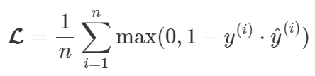
Hinge Loss
Hinge Loss, also known as max-margin objective, is a loss function used for training classifiers. The hinge loss is used for “maximum-margin” classification, most notably for support vector machines (SVMs). For an intended output y(i) = ±1, i.e., binary classification and a classifier score ^y(i), the hinge loss of the prediction y is defined as

Slide 40
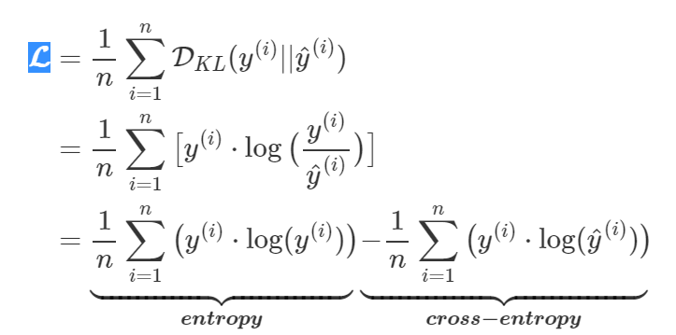
Kullback-Liebler (KL) Divergence
KL Divergence, also known as relative entropy, information divergence/gain, is a measure of how one probability distribution diverges from a second expected probability distribution. KL divergence loss function is computed by

Slide 41
Kullback-Liebler (KL) Divergence
where the first term is entropy and another is cross entropy.
KL divergence is a distribution-wise asymmetric measure and thus does not qualify as a statistical metric of spread. In the simple case, a KL divergence of 0 indicates that we can expect similar, if not the same, behavior of two different distributions, while a KL divergence of 1 indicates that the two distributions behave in such a different manner that the expectation given the first distribution approaches zero.

